Slide 1
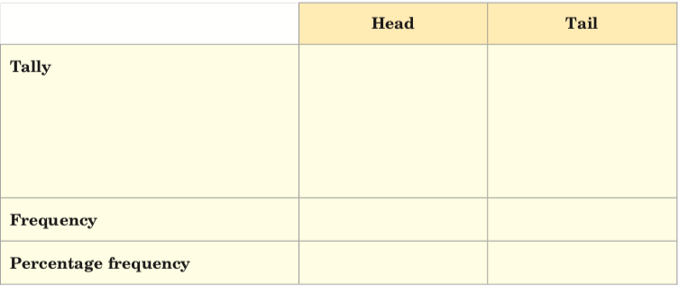
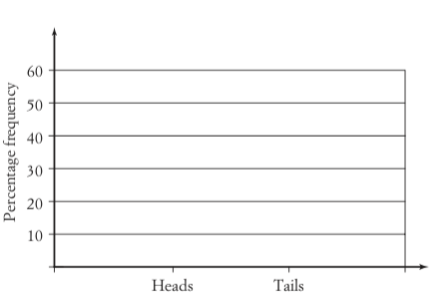
Starter – Part 1 of 2
Prediction: If you tossed a coin 20 times, how many times do you think it would land on heads? How many times on tails? In your INB, draw a table and a graph and record your predictions in the table and draw them as a bar graph.

Slide 2
Starter – Part 2 of 2
Actual: Working with a partner, toss a coin 20 times and record your results in your table drawing a new one if you have no room, then graph them.
How do your actual results differ from your predicted results?
Discuss as a class

Slide 3
Topic: Probability
EQ: What is the difference between theoretical and experimental probability?

Slide 4
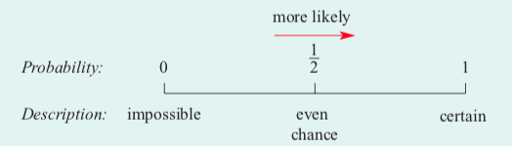
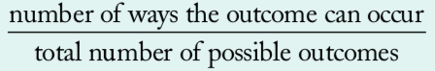
Topic: Probability
EQ: What is the difference between theoretical and experimental probability?
Let’s review some of what we know already:
Theoretical probability is determining the chance of an event occurring. It is:

Slide 5
Answer the following
Find the probability of picking;
A yellow circle
b) A blue circle
c) A grey circle
d) A square
e) A circle
Notes:
Check for understanding/ guided practice

Slide 6
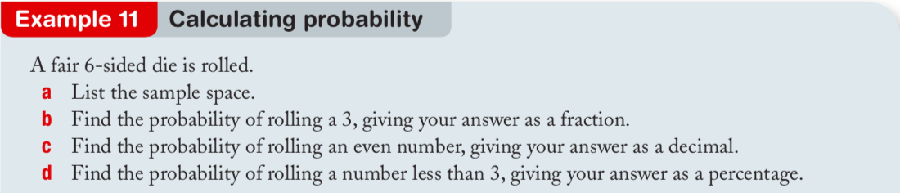

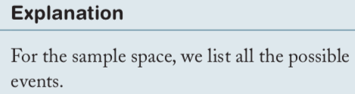
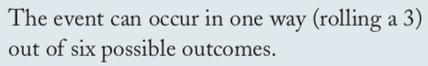
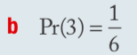
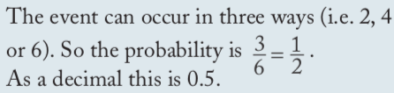
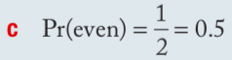
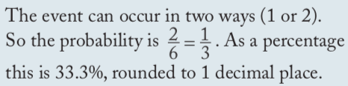
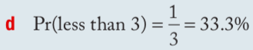
Notes:
Check for understanding/ guided practice

Slide 7

Practice
Exercise 9.3 – Theoretical Probability Worksheet
Notes:
Independent practice

Slide 8
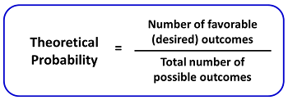
Last Lesson Recap
What is Theoretical Probability?
Theoretical probability is determining the chance of an event occurring
Notes:
• Share with students what they are learning or will be able to do
• Why the lesson is important

Slide 9
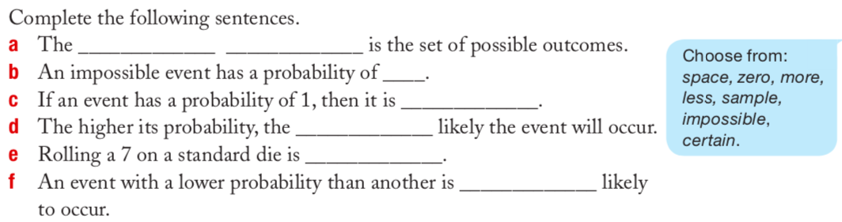
Vocabulary Refresher
Notes:
Closure

Slide 10
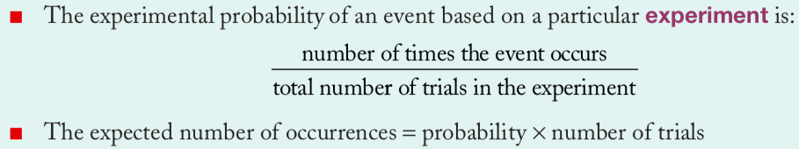
Topic: Probability
EQ: What is the difference between theoretical and experimental probability?
What is Experimental Probability?
Difference between Theoretical and Experimental Probability
Theoretical probability is what we expect to happen
Experimental probability is what actually happens when we try it out.
Before we tell you, think back to some of the predictions you’ve made (flipping a coin 20 times – how many heads did you predict?). Now think about how many times the experiment has worked out exactly how you predicted. What is the difference? Can we come up with a definition as a class?

Slide 11
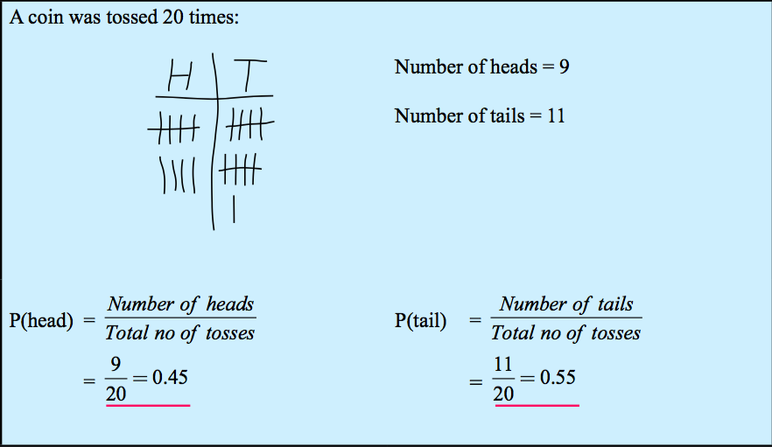
Example
In this example, the theoretical and experimental probability differ. Theoretically, we should get 10 heads and 10 tails. But when we actually did the experiment, we got different results
Notes:
• Give students the opportunity to practise with teacher guidance
• Provide immediate and specific feedback with knowledge of results

Slide 12
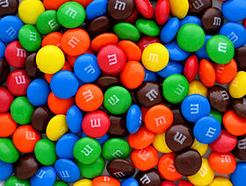
M&M Experiment
Which color are you most likely to get?

Slide 13

Step 1
Glue the table into your book on the task page
Count the number of all M&Ms in your packet
Count the number of M&Ms for each color.
Fill in your table

Slide 14

Step 2
Analyze your results by responding to the following questions.
According to your results, which color is most likely? Which color is least likely?
What is the sample space for picking an M&M in your package?
Is picking a blue or orange candy more likely? Why?
Do you have any colors that have equally likely outcomes? Explain!
What is the probability of:
picking an orange M&M?
picking an orange or a yellow M&M?
not picking an orange M&M?
not picking an orange or a yellow M&M?
Did we calculate and examine theoretical or experimental probability? How do you know?

Slide 15
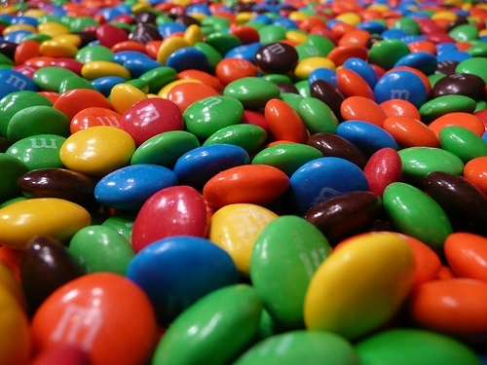
Step 3
According to the M&M website, each package of milk chocolate M&M contains…
24% Blue
14% Brown
16% Green
20% Orange
13% Red
14% Yellow
How does your M&M data compare to the theoretical data?
You can now EAT your M&Ms

Slide 16
Class/Homework
Essentials Mathematics Gold 7
Chapter 8: Statistics and Probability Worksheet B

Slide 17
Exit ticket
Write a summary answering the essential question.
Add at least three new terms to your glossary
Make sure these terms are added to the class’s Probability Poster

